Slide 1


A Mini Project on
“Deep Fake Audio
Detection”
Presented By
1. Saad Inamdar 58
2. Sagar Birajadar 59
3. Arshad Perampalli 63
Class : T.Y. Sem.-II
Under the guidance of
Prof. A. S. Adhatrao
Department of Artificial Intelligence & Data Science
N.K. Orchid College of Engineering & Technology, Solapur.
2024-2025

Slide 2
Contents
Introduction
Literature Review
Motivation and Problem statement
Requirement Analysis
Design
6. Implementation
7. Result and Discussion
8. Conclusion

Slide 3
Introduction
The Fake Audio Detection System identifies whether a given voice sample is genuine or artificially generated. It uses deep learning, PyTorch, and Wav2Vec2-based models to analyze audio patterns. The system converts audio into spectrograms or embeddings and classifies them using neural networks.

Slide 4
Literature Review
Deepfake audio is a rising concern due to misuse in fraud, misinformation, and media manipulation.
Previous works used spectrogram-based CNNs and traditional ML.
We integrated Wav2Vec2 (transformer model) for advanced feature extraction and better performance.
Use of Google Colab, Librosa, Torchaudio, and Transformers libraries for efficient model training.

Slide 5
Motivation and Problem statement
Motivation
Fake audio is increasingly used for misinformation and fraud Detection such audio is essential for maintaining trust and security in digital communications.
Problem Statement
To develop an AI-based system that accurately detect and classifies fake vs real audio using deep learning and pre-trained models.

Slide 6
Requirement Analysis
Python – Core implementation
PyTorch – Custom CNN Model
Transformers (HuggingFace) – Wav2Vec2
Google Colab – Development platform
Librosa / Torchaudio – Audio preprocessing
Sklearn – Metrics, splitting, and visualization
Streamlit – UI for deployment
Dataset – "The Fake or Real Dataset" from Kaggle

Slide 7
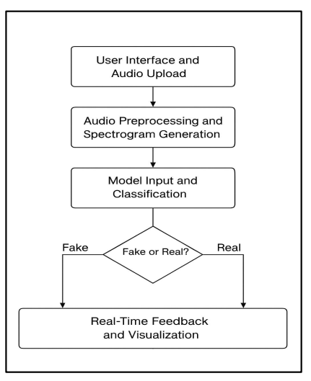
Design
The system processes labeled audio samples by converting them to 16kHz and applying truncation or padding. Features are extracted using Mel spectrograms for a custom CNN with 1D Conv layers, and Wav2Vec2 embeddings for a pre-trained transformer model with a classifier head. The final output classifies the audio as fake or rea.

Slide 8
Implementation
Split dataset into train, validation, and test
Built custom AudioDataset class
Uploaded Kaggle dataset using Kaggle API
Implemented two models
Custom 1D CNN
Wav2Vec2-based classifier
Trained and evaluated both models
Deployed Streamlit app for real-time predictions
Integrated Google Drive for saving/loading models

Slide 9
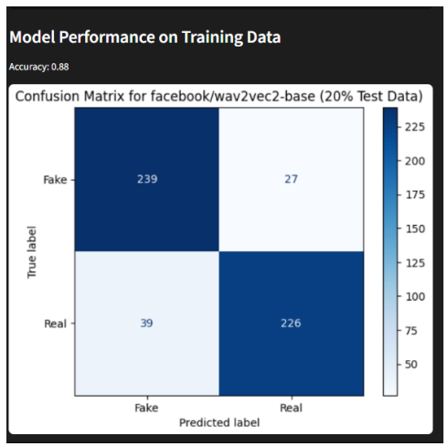
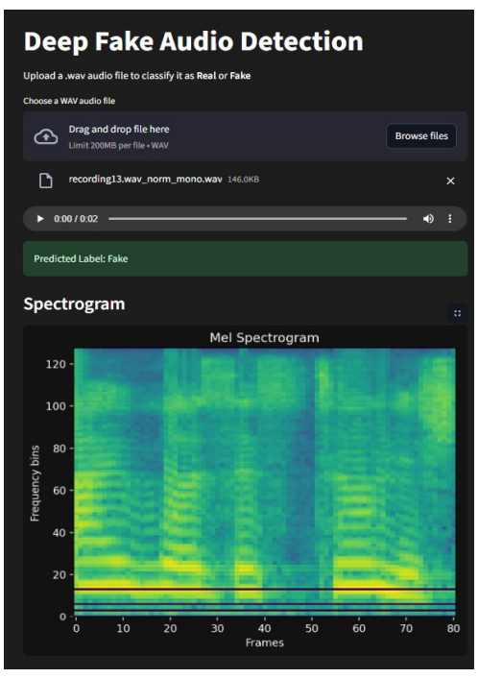
Result and Discussion
After classification, the results are displayed in real-time on the Streamlit interface:
Audio playback option, Mel Spectrogram visualization, Classification result (Fake or Real).

Slide 10
Conclusion
The Fake Audio Detection System effectively detects fake audio using deep learning and transfer learning techniques. It shows promising accuracy with Wav2Vec2 outperforming traditional CNNs. The project demonstrates real-world application of AI in audio forensics with a user-friendly interface.

Slide 11

THANK YOU

